Slide 1
Ron Wilson
Leveraging Wiring the Winning Organization for Organizational Transformation

Slide 2
About the Book
“Wiring the Winning Organization: Liberating Our Collective Greatness through Slowification, Simplification, and Amplification” by Gene Kim and Steven J. Spear
https://myresources.itrevolution.com/id006657164/Wiring-the-Winning-Organization
Ron Wilson
Leveraging Wiring the Winning Organization for Organizational Transformation

Slide 3
Authors: Gene Kim
Gene Kim has written many books
DevOps Handbook
Accelerate
Phoenix Project
Unicorn Project
Wiring the Winning Organization
Highly recommended
Ron Wilson
Leveraging Wiring the Winning Organization for Organizational Transformation

Slide 4
Authors: Steven J. Spear
I have had the opportunity to meet Steven J. Spear recently and gained some valuable insight about Wiring the Winning Organization
Senior lecturer at MIT Sloan.
https://mitsloan.mit.edu/faculty/directory/steven-spear
Ron Wilson
Leveraging Wiring the Winning Organization for Organizational Transformation

Slide 5
INTRODUCTION
Ron Wilson
Leveraging Wiring the Winning Organization for Organizational Transformation

Slide 6
Organizational Transformation
Today we will discuss several principles related to Organizational Transformation.
These principles come from the “Wiring the Winning Organization” book.
We will review a Case Study and learn how practical examples demonstrate these principles.
At the end of this presentation, you will have a greater understanding of these principles and be equipped to lead your organization in Organizational Transformation.
Ron Wilson
Leveraging Wiring the Winning Organization for Organizational Transformation

Slide 7
Why is Change Necessary?
Change is needed to make the organization more effective.
Changes can be small such as modifying an existing process.
Changes can be large such as moving from Waterfall to Agile.
Processes might be established but aren’t being followed so this also requires an organizational change to follow those processes.
Without change, the organization will become stagnant and will struggle to remain relevant and be unable to keep up with competition.
Ron Wilson
Leveraging Wiring the Winning Organization for Organizational Transformation

Slide 8
Leadership and Organizational Transformation
Organizational Transformation requires leaders who are change agents and help influence change.
Organizational Transformation requires leaders at all levels of the organization.
Everyone can be a Leader; it doesn’t require a formal title.
Ron Wilson
Leveraging Wiring the Winning Organization for Organizational Transformation

Slide 9
Organizational Transformation-Examples
Toyota: Significantly increased quality and reduced the amount of time required to build a car
Apple: Created the iPhone and resigned the way phones were used
Amazon: Changed the way software was deployed. Went from dozens of deployments per year to 136k deployments per day.
Ron Wilson
Leveraging Wiring the Winning Organization for Organizational Transformation

Slide 10
WINNING PRINCIPLES
Ron Wilson
Leveraging Wiring the Winning Organization for Organizational Transformation

Slide 11
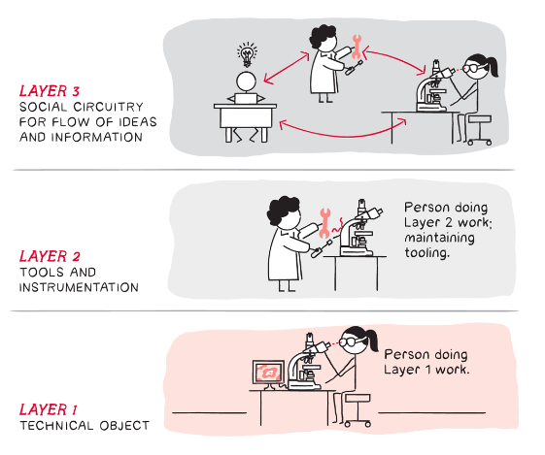
The Three Layers
There are three layers where we create value:
Layer 1: The technical objects we create or enhance.
Layer 2: The tools we use.
Layer 3: The social circuitry such as processes, procedures, and collaboration norms to organize our efforts.
Ron Wilson
Leveraging Wiring the Winning Organization for Organizational Transformation

Slide 12
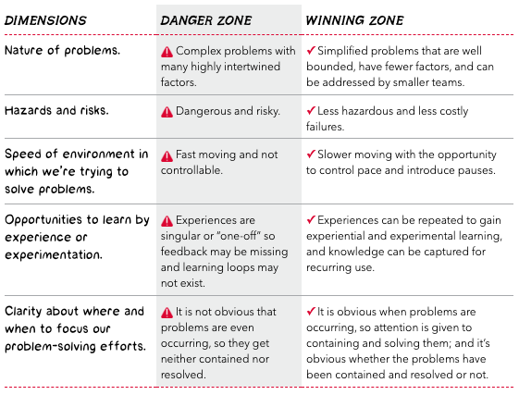
Danger Zone vs. Winning Zone
Complex problems are encountered in layer 3
Will determine success or failure of an organization
Problems are often intertwined, and they must be broken down into smaller pieces
Ron Wilson
Leveraging Wiring the Winning Organization for Organizational Transformation

Slide 13
Leadership in Social Circuitry
Leaders create the conditions where the people they manage can achieve the goals and objectives which they are responsible.
Leader is responsible for everything required to enable the work to be completed and done well.
Winning organizations operate in a way where leaders are supportive of what is happening in layer 3 to achieve layer 1 and layer 2.
Leadership role is supportive.
Leader monitors the conditions and adapts and adjusts conditions for success.
More than servant leadership. This model has the leaders actively engineering the social circuitry of the organization to achieve success.
Ron Wilson
Leveraging Wiring the Winning Organization for Organizational Transformation

Slide 14
Three Mechanisms
Slowification: make problems easier to solve
Simplification: make problems simpler to solve
Amplification: make it obvious there are problems that demand attention and whether they have been seen and solved
Ron Wilson
Leveraging Wiring the Winning Organization for Organizational Transformation

Slide 15
SLOWIFICATION
Ron Wilson
Leveraging Wiring the Winning Organization for Organizational Transformation

Slide 16
Slowification – Fast and Slow Thinking
Fast Thinking is rules-based.
We identify a precalculated process or decision, apply it to a situation, and move forward.
Problems arise when the situation doesn’t match a rule, or the wrong rule is selected.
You can’t make new rules in the middle of fast thinking.
Slow Thinking allows us to develop new rules.
We can take the time to analyze something in depth and adjust or create rules.
It is very slow compared to Fast Thinking and isn’t always the best use of time.
Slow Thinking is what we do during RCAs, for example.
Ron Wilson
Leveraging Wiring the Winning Organization for Organizational Transformation

Slide 17
Slowification – Cognitive Biases
Cognitive Biases are subconscious hacks where our brains reuse existing rules for new situations. Some of the most common in engineering are:
Well-traveled road effect: You underestimate the time it takes to do something new because you’ve done something similar many times before.
Confirmation bias: Only believing information that confirms your pre-existing belief (which was probably founded on a lack of information in the first place).
Conservatism bias: Inadequately adjusting your belief when presented new information.
Framing effect: Drawing different conclusions depending on the order information presents.
Ron Wilson
Leveraging Wiring the Winning Organization for Organizational Transformation

Slide 18
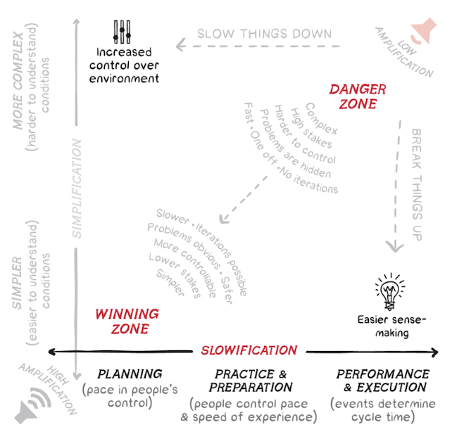
Slowification – 3 P’s
The Three P’s: Plan, Practice, and Perform:
Plan in a Slow Thinking environment.
Practice by iterating, validating, and learning.
Perform at full operational pace.
“Slowification … [shifts problem-solving] from the faster-moving performance environment to one that is slower-moving and more forgiving….”
Ron Wilson
Leveraging Wiring the Winning Organization for Organizational Transformation

Slide 19
Slowification – Capture Knowledge
There are many ways to capture knowledge:
Online Training
Centralized Online Content (SharePoint, Confluence)
Lunch and Learn
Sprint/Release Planning
Daily Standups
Stakeholder Demos
Ron Wilson
Leveraging Wiring the Winning Organization for Organizational Transformation

Slide 20
SIMPLIFICATION
Ron Wilson
Leveraging Wiring the Winning Organization for Organizational Transformation

Slide 21
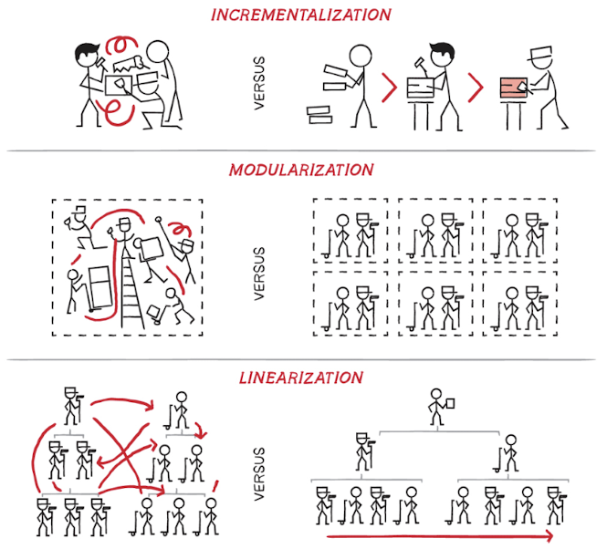
Simplification – Other Principles
Incrementalization: Breaks the new stuff out from the old stuff.
Modularization: Breaks large things into smaller things.
Linearization: Decouples things so multiple people can work on them.
Ron Wilson
Leveraging Wiring the Winning Organization for Organizational Transformation

Slide 22
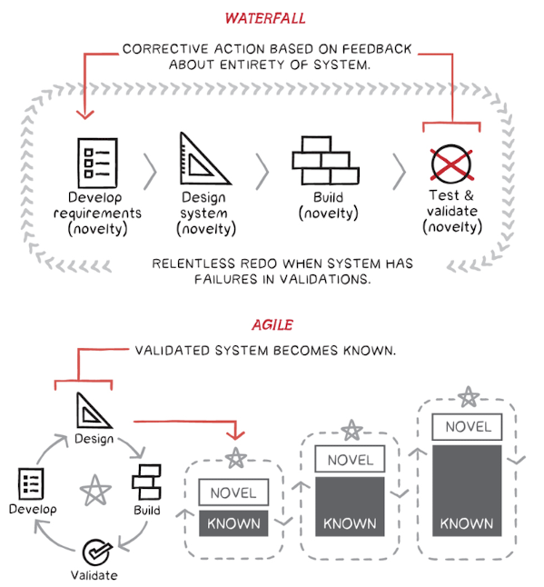
Simplification – Incrementalization
Incrementally add new things on to old things. Don’t do it all at once.
Allows novel implementations to grow naturally based on iterative learning and understanding.
Avoids the impossible task of estimating large blocks of unknown work at the beginning.
Also lets you stop when it’s good enough.
Ron Wilson
Leveraging Wiring the Winning Organization for Organizational Transformation

Slide 23
Simplification – Modularization
Break down large, complex things into smaller, simple things.
Do this until the things left to implement are easy to understand.
As much as possible, make it so these things can be implemented in parallel by different people (Linearization).
The scope for each team in a Modularized project will be less because the modules will fit together in agreed upon ways (pre-integrated) as they’re ready.
Ron Wilson
Leveraging Wiring the Winning Organization for Organizational Transformation

Slide 24
AMPLIFICATION
Ron Wilson
Leveraging Wiring the Winning Organization for Organizational Transformation

Slide 25
Amplification
When a problem occurs, regardless of where, it needs to be escalated until it receives the resources necessary to fix the problem.
These problems might occur at one of three levels:
Level 1: The work in front of us; the objects we create or enhance.
Level 2: The tools and systems through which we work.
Level 3: The social circuitry of our organization.
Layer 3 is responsible for amplifying the problem in a way that it will be resolved.
Ron Wilson
Leveraging Wiring the Winning Organization for Organizational Transformation

Slide 26
Amplification- Escalation
An organization must have defined paths of escalation.
Escalations can be initiated at any level.
Escalation must include bringing in managers who control the resources (people, money, equipment) to resolve the problem.
Ron Wilson
Leveraging Wiring the Winning Organization for Organizational Transformation

Slide 27
CASE STUDY-POWIN
Ron Wilson
Leveraging Wiring the Winning Organization for Organizational Transformation

Slide 28
Powin
Initially started as a recommendation to read the book for the software leadership team
The leader of the team read the book, encouraged others to read the book and made a presentation for the whole organization
Team leveraged principles from the book and terminology to make incremental changes
Powin has a long way to go, we aren’t there yet!
Ron Wilson
Leveraging Wiring the Winning Organization for Organizational Transformation

Slide 29
Powin: Danger Zone to Winning Zone
Dimensions | Danger Zone | Winning Zone
Documentation | Poor. Some information was documented by not kept up to date. The most current information was stored in the heads of key team members. | More emphasis placed on creating better requirements and specification documents and updating when things are changed.
Knowledge | Senior leaders of teams. Lack of time to share and document. | Information was documented and cross-training was distributed across teams
Process | There was a loosely defined process but was often not followed. It was poorly documented. | Documented and implemented a process. Shared the process with the entire team. Reinforced process when it isn’t followed.
Ron Wilson
Leveraging Wiring the Winning Organization for Organizational Transformation

Slide 30
Powin-Slowification in Action
A new feature was being developed but it was riddled with defects when it got to QA. Instead of pushing through, testing was paused, development put more effort in unit and smoke tests, then testing resumed which resulted in less defects in testing which increased testing velocity.
A complex feature needed to be tested. The test cases were at a high-level and we had several different sets across multiple teams. Testing needed to be completed at the integration level but there was confusion in how the whole product needed to be tested. Instead of pushing through the chaos, testing was paused and detailed test cases were created which improved product knowledge and helped to reduce future frustration for subsequent releases.
Ron Wilson
Leveraging Wiring the Winning Organization for Organizational Transformation

Slide 31
Powin – Capture Knowledge
Corporate training
Lunch and Learn
Sessions are recorded for reference and new team members
Checklists
Cross training across teams
Stakeholder Demos
JIRA
Test cases
Automated test cases
Ron Wilson
Leveraging Wiring the Winning Organization for Organizational Transformation

Slide 32
Powin-Simplification in Action
New features were being developed and the timeline to complete development and testing spanned multiple releases. Instead of continuing to operate in this way, features were split in increments and features were deployed faster to the customer.
There are a series of testing activities which need to be completed for a given feature. While those processes are defined within the Standard Operating Procedures document, they weren’t always being followed. A series of Jira tasks were automatically created with each new feature. This helped to ensure those processes were consistently followed across all teams.
Ron Wilson
Leveraging Wiring the Winning Organization for Organizational Transformation

Slide 33
Powin-Amplification in Action
New feature development wasn’t being followed. Several features were put on hold until Acceptance Criteria, Checklists were updated before development and testing resumed
While working on a critical project, defects were impacting the ability to complete testing. Each blocking defect was escalated so those defects would get resolved and testing could complete.
Ron Wilson
Leveraging Wiring the Winning Organization for Organizational Transformation

Slide 34
CONCLUSION
Ron Wilson
Leveraging Wiring the Winning Organization for Organizational Transformation

Slide 35
Conclusion
Organizational Transformation is hard.
It requires change agents at all levels or the organization.
It will not happen all at once. The most effective approach is a series of small changes which will produce big results.
Failure is accepted and encouraged.
If you want to get started…
Ron Wilson
Leveraging Wiring the Winning Organization for Organizational Transformation

Slide 36
Conclusion – Next Steps
1. Read Wiring the Winning Organization.
2. Recommend a few of the key leaders within your organization read the book and ask them if they would like regular meetings to review the book chapter by chapter.
3. Identify ways to make a few small changes within the organization as a proof of concept.
4. Implement within the broader organization.
You are a leader. Go forth and conquer!
Ron Wilson
Leveraging Wiring the Winning Organization for Organizational Transformation

